Slide 1
House Price Prediction -Analysis by Pandas
By Min Henderson

Slide 2

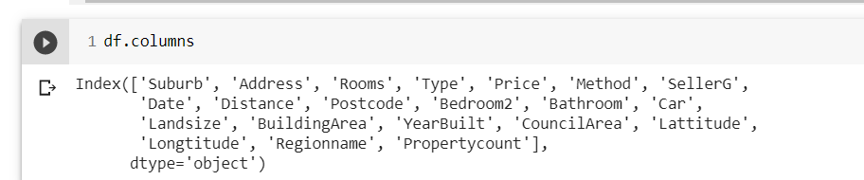
Dataset
Melb_data from Kaggle
13580 Rows, 21 Columns
Notes:
As a passionate learner, I am drawn to the process of learning new things.
I can quickly adapt to new jobs. My work performance reflects these strengths and have allowed me to succeed in my work environments.

Slide 3

Clean Data
df. isnull( ). Sum( )
Check missing or NAN data, then fill with mean.
Df.fillna(df.mean(), inplace=True

Slide 4
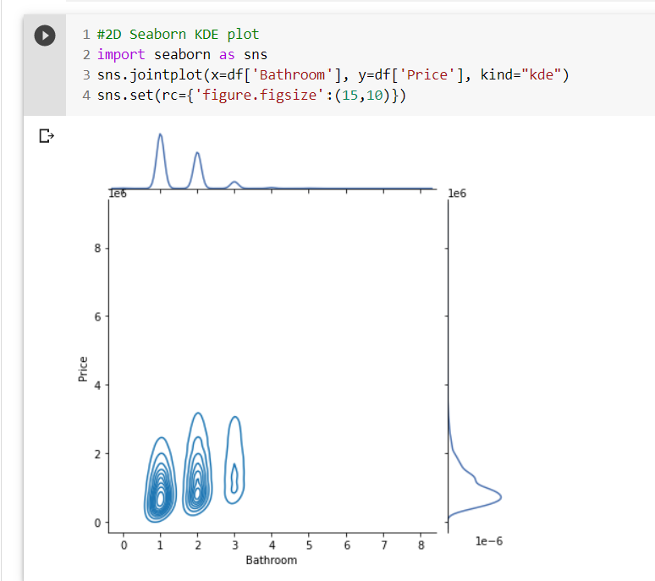
Data Visualization

Slide 5
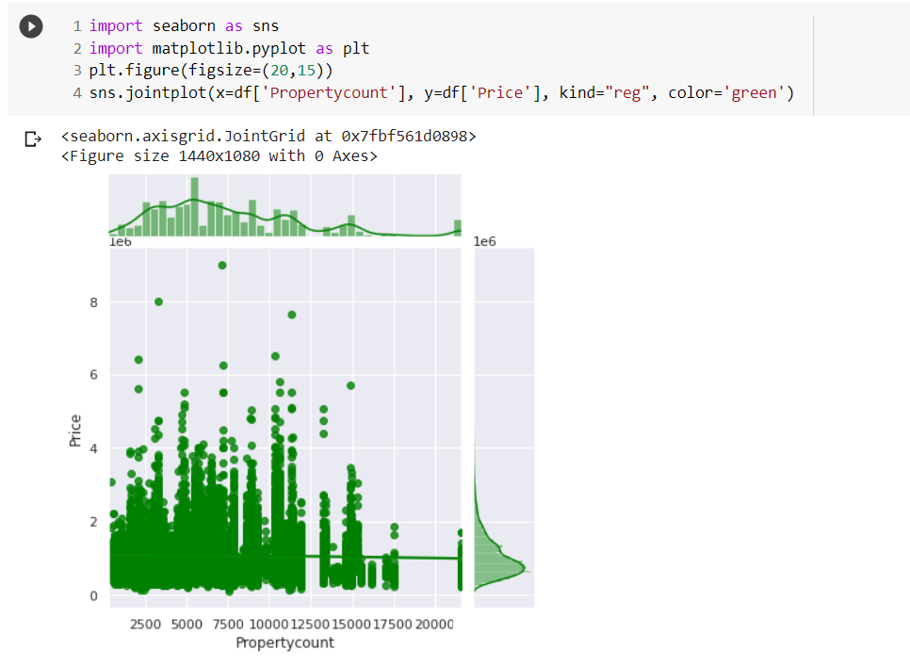
Data Visualization
Apply Seaborn Jointplot

Slide 6
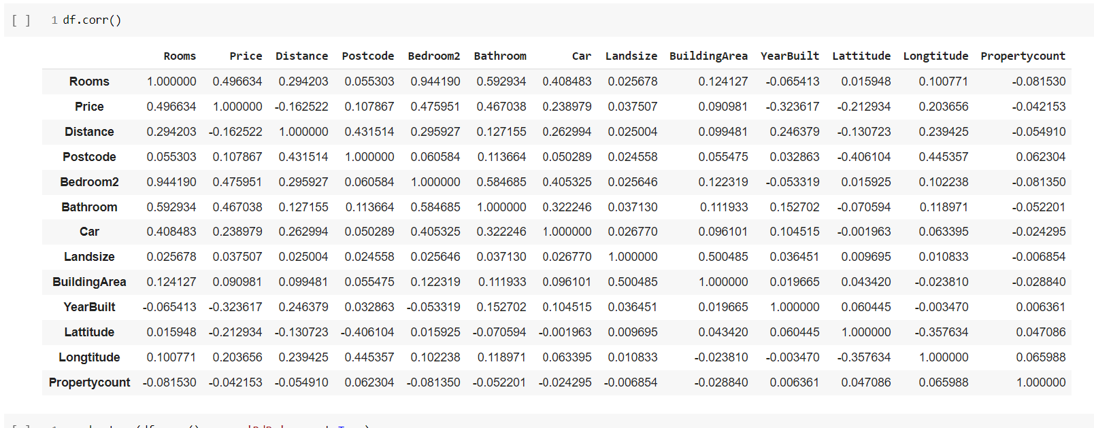
Find Correlation

Slide 7
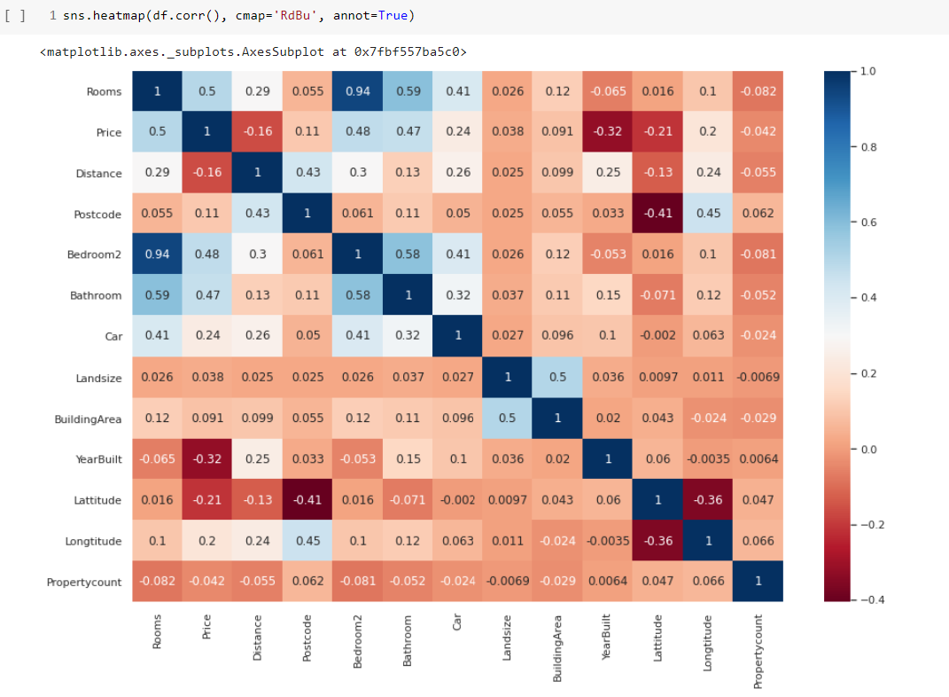
Visualization Correlation
From the higher number and the darker color, we can tell the close relationship.

Slide 8

Prepare data for Modling
I choose Price for Target data.
Leave other features for the feature.

Slide 9
Slpit Data

Slide 10
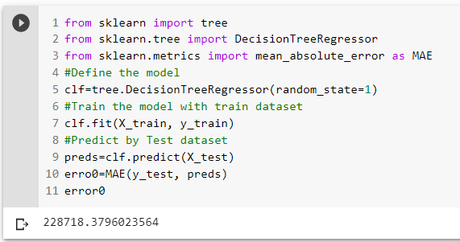
Modeling and Predict

Slide 11
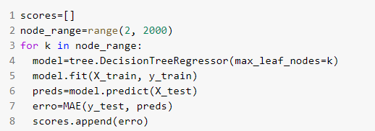
Make a Function to Tweak

Slide 12
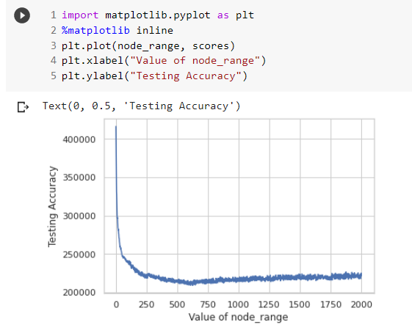
Visulize the Trend

Slide 13
Next Step
Change strings into numbers to discover the correlation.
Test with other models.

Slide 14

All pics are from Google.com

